Slide 1

SEPTA Cuts Impact Analysis
Zhanchao Yang, Chuwen Zhong
Department of City and Regional Planning
Weitzman School of Design

Slide 2
Table of contents
01
02
03
04
Introduction
Method
Results
Conclusion

Slide 3
01
Context

Slide 4
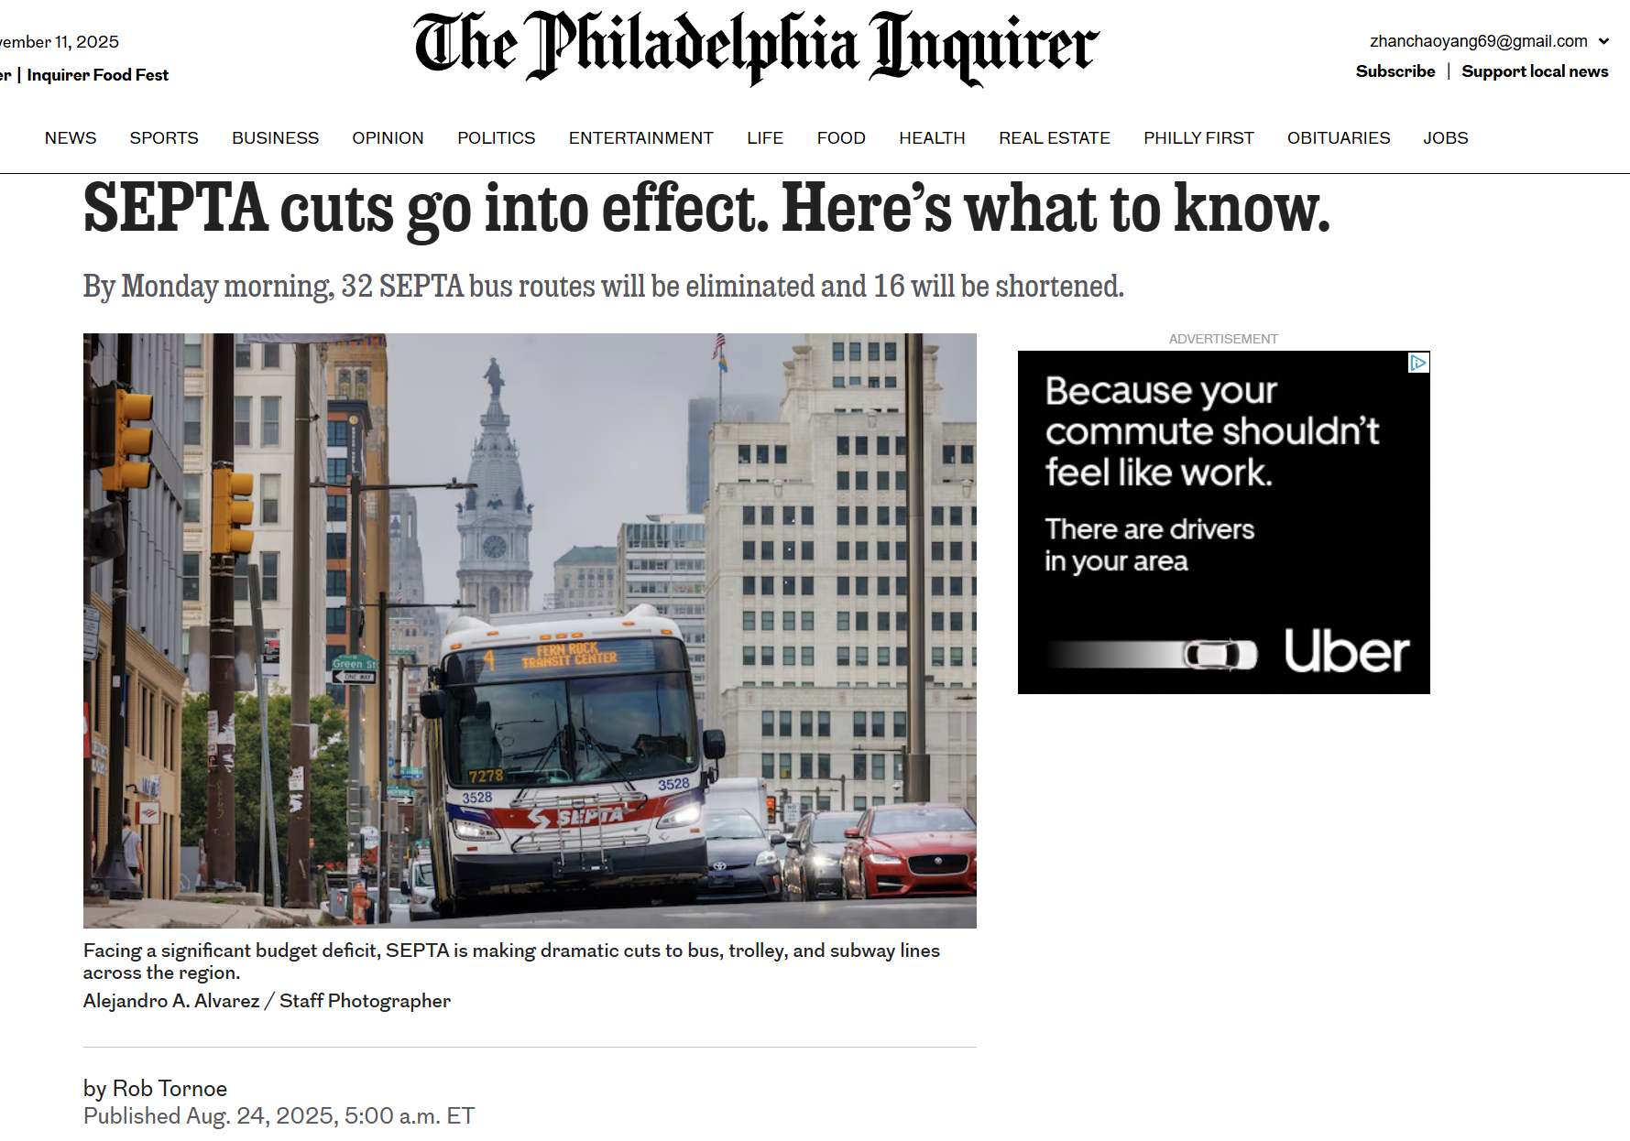

Slide 5
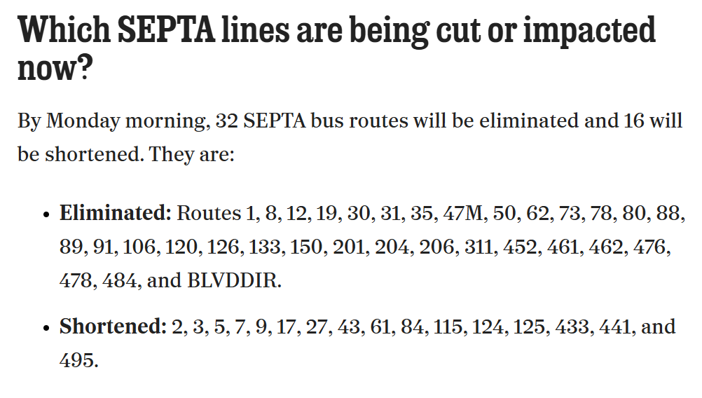
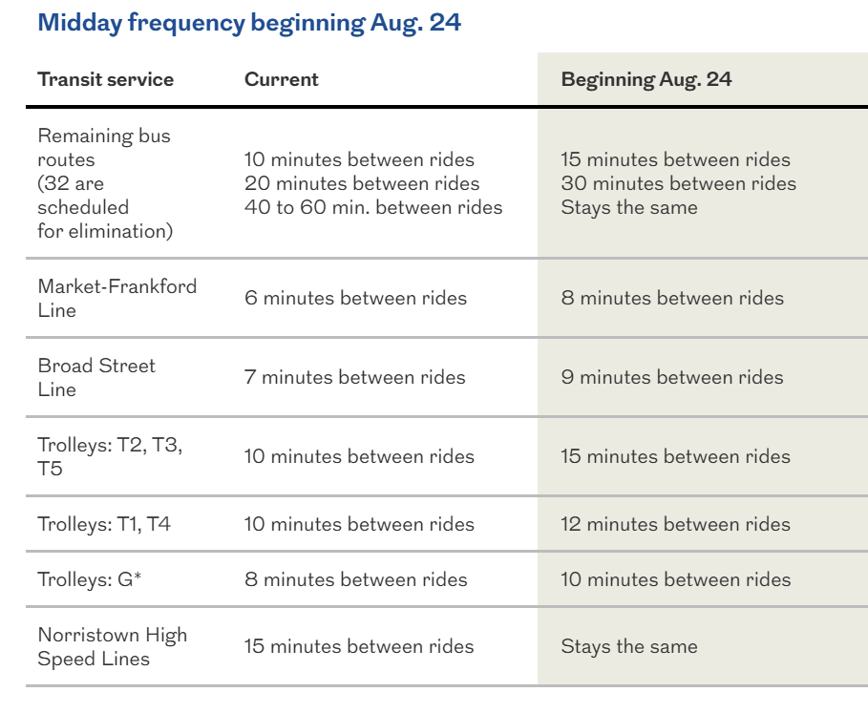
What has been Cut?

Slide 6
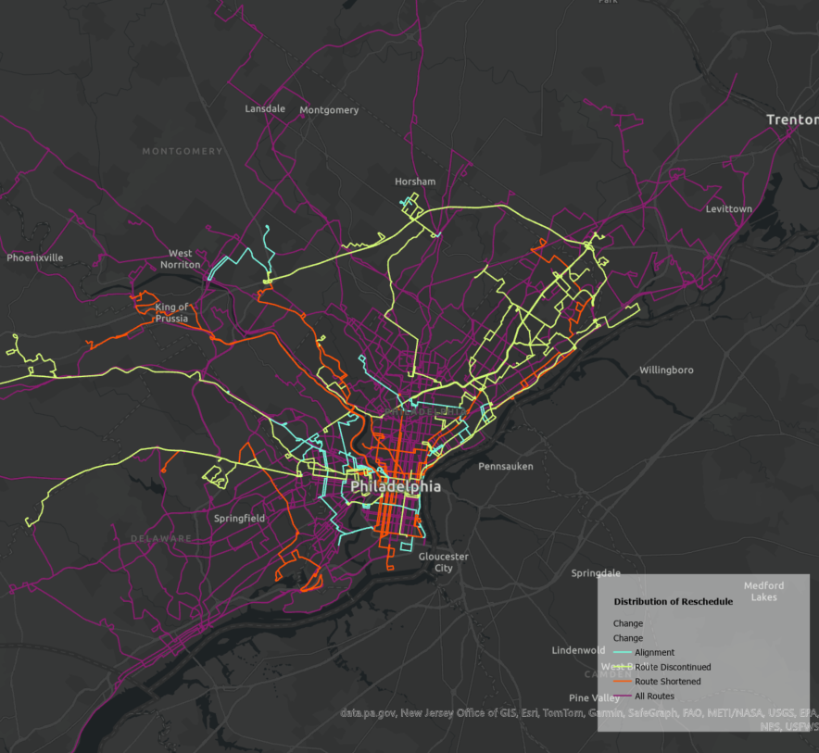
Distribution of Route Discontinue
Not uniform

Slide 7
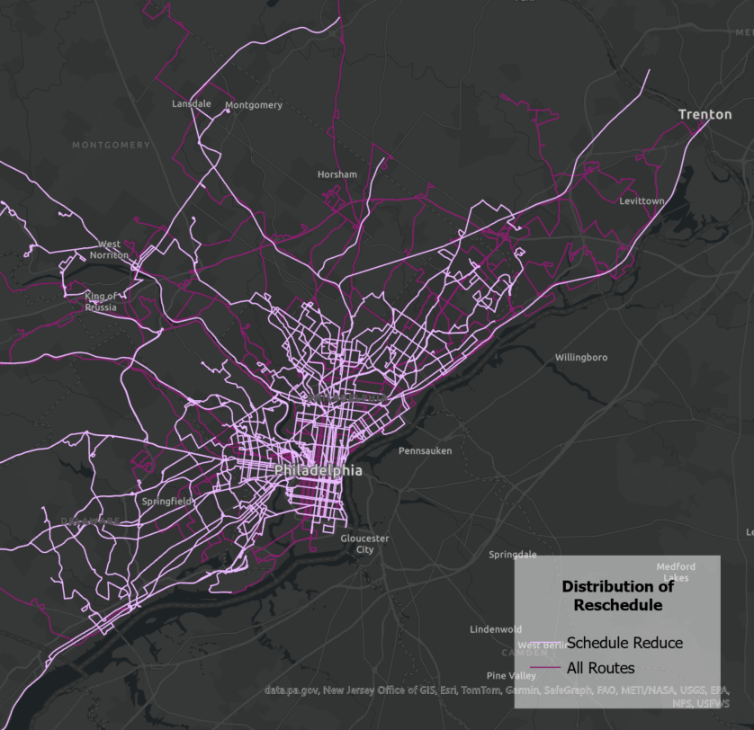
Distribution of Headway Change
Uniform

Slide 8
Purpose of the Study
“Service on Route xxx will be reduced by up to 20%. Peak headways will go from 15 to 20 minutes. Midday headways will go from 15 to 20 minutes.”
Impact on riders? What Magnitude?
Notes:
The previous headway summary is technical—it shows schedule changes, but does not fully capture how those changes feel to riders in the real world.
Service frequency is reduced by up to ~20% on some routes, which means fewer chances to catch the bus and a higher risk of missing trips.
Peak headways increase (e.g., from 15 to 20 minutes), so workers may have to leave earlier or risk being late to jobs, classes, or appointments.
Midday headways also increase, making it harder to string together errands, caregiving trips, and part-time work across the day.
Effective travel times grow because riders must build in extra “buffer” time to avoid being stranded by less frequent service.
Commuting trips become less reliable, especially for workers with inflexible start times, shift work, or multiple jobs.
Some “choice riders” may shift to driving or other modes, but transit-dependent riders have no easy alternatives and absorb the full cost of these cuts.

Slide 9
02
Method

Slide 10
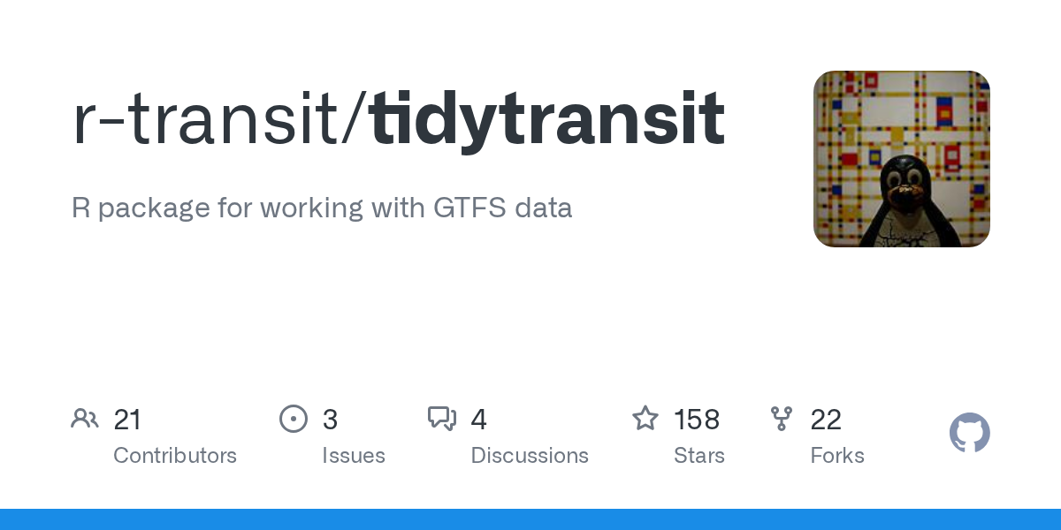

Step by Step
tidytransit
r5r
GTFS-based summary using tidytransit
Travel time modeling using R5R (GTFS-based)
Door-to-door travel times
Post-processing
1-hour analysis windows (Peak and non-peak) with 15-minute departure intervals
Average the travel time differences

Slide 11
03
Results

Slide 12
3.1
GTFS Analysis

Slide 13
Peak hour and Midday Assumption
Peak period: 7:30 AM – 9:30 AM
Midday period: 11:00 AM – 1:00 PM
Note on limitations: A margin of error of approximately ±1 trip. For example, a bus scheduled at 7:29 AM would fall outside the peak-hour window and therefore not be counted. If the schedule is later updated and the same trip is shifted to 7:31 AM, it would now be included. In this sense, a slight schedule change can result in a difference of approximately one trip in the total count for a given time window.

Slide 14
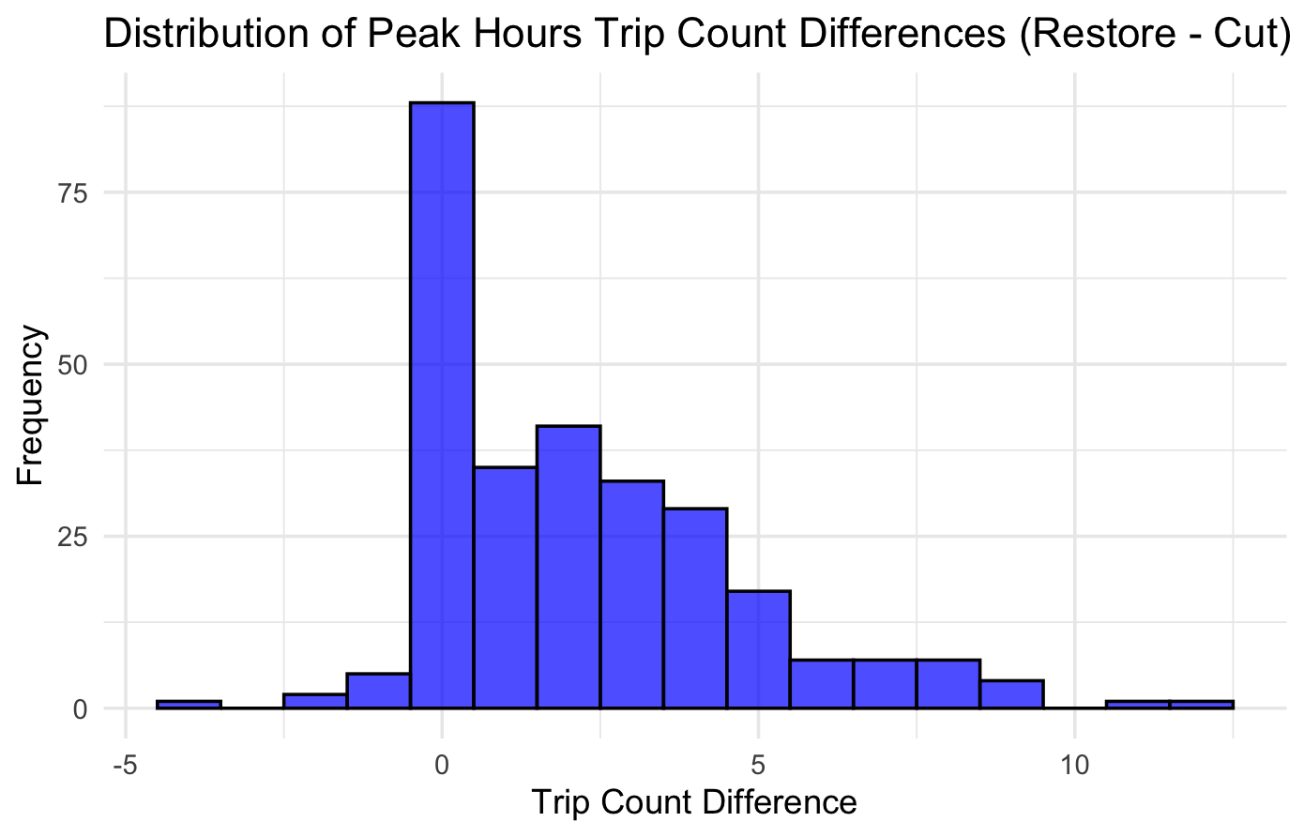
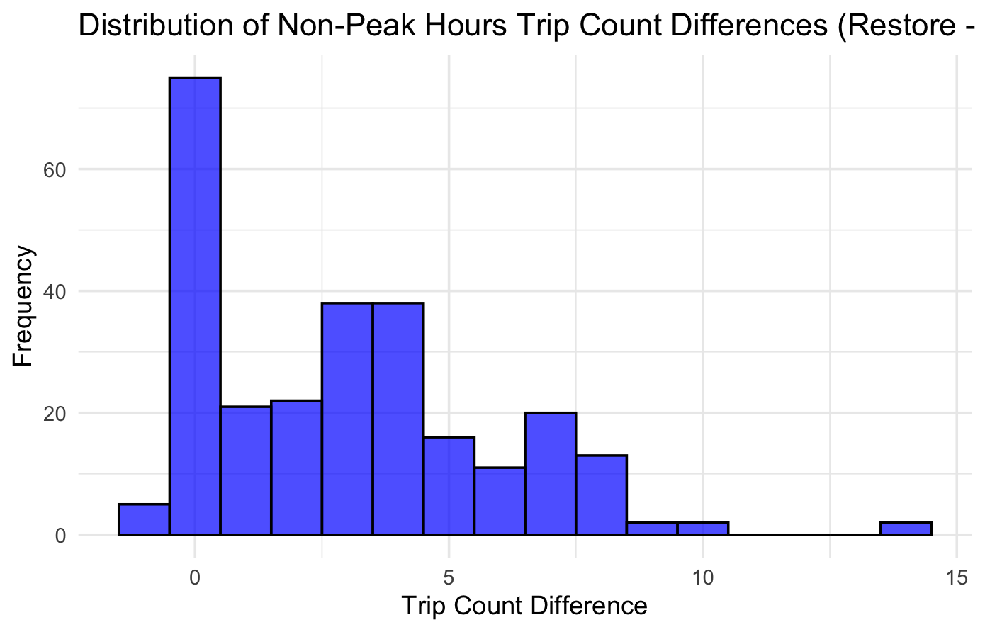
Peak hour Capacity Changes by Route

Slide 15
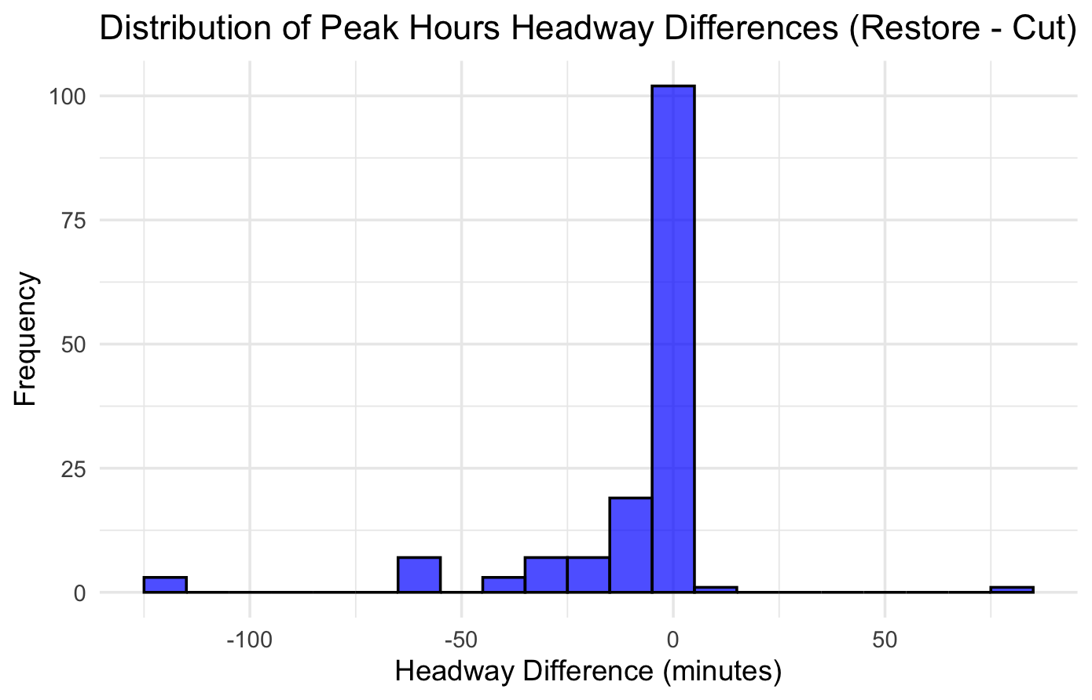
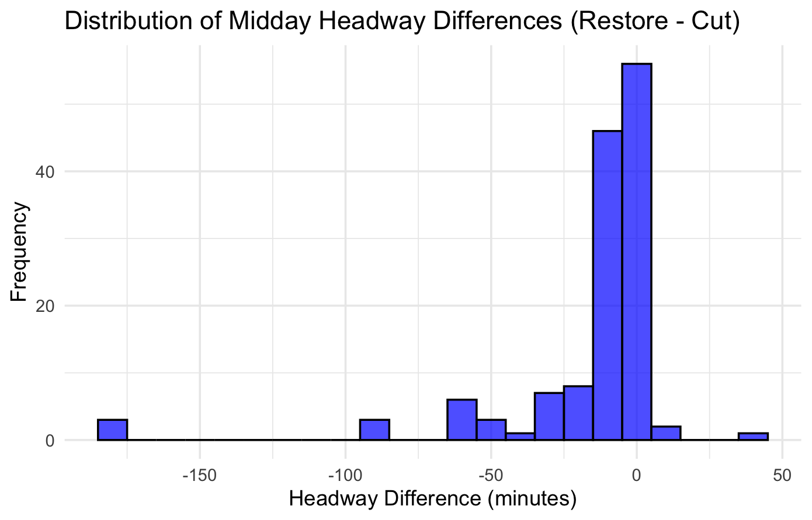
Headway Changes by Route

Slide 16
3.2
Travel Time Analysis

Slide 17
Travel Time Analysis Assumption
Start Point: Centroid of Each Census Tract
End Point: City Hall
Max Travel Time: 3 hours (180 Minutes)
Max Walking Distance: 3 km
Walking Speed: 1.3 m/s (4.68 km/h)
Peak period: 8:30 AM – 9:00 AM (5-minute interval)
Midday period: 11:30 AM – 12:00 PM (5-minute interval)
av$erage change(\%)=\frac{average travel time \left(before\right)−average travel time(after)}{average travel time (before)} ×100\%$

Slide 18
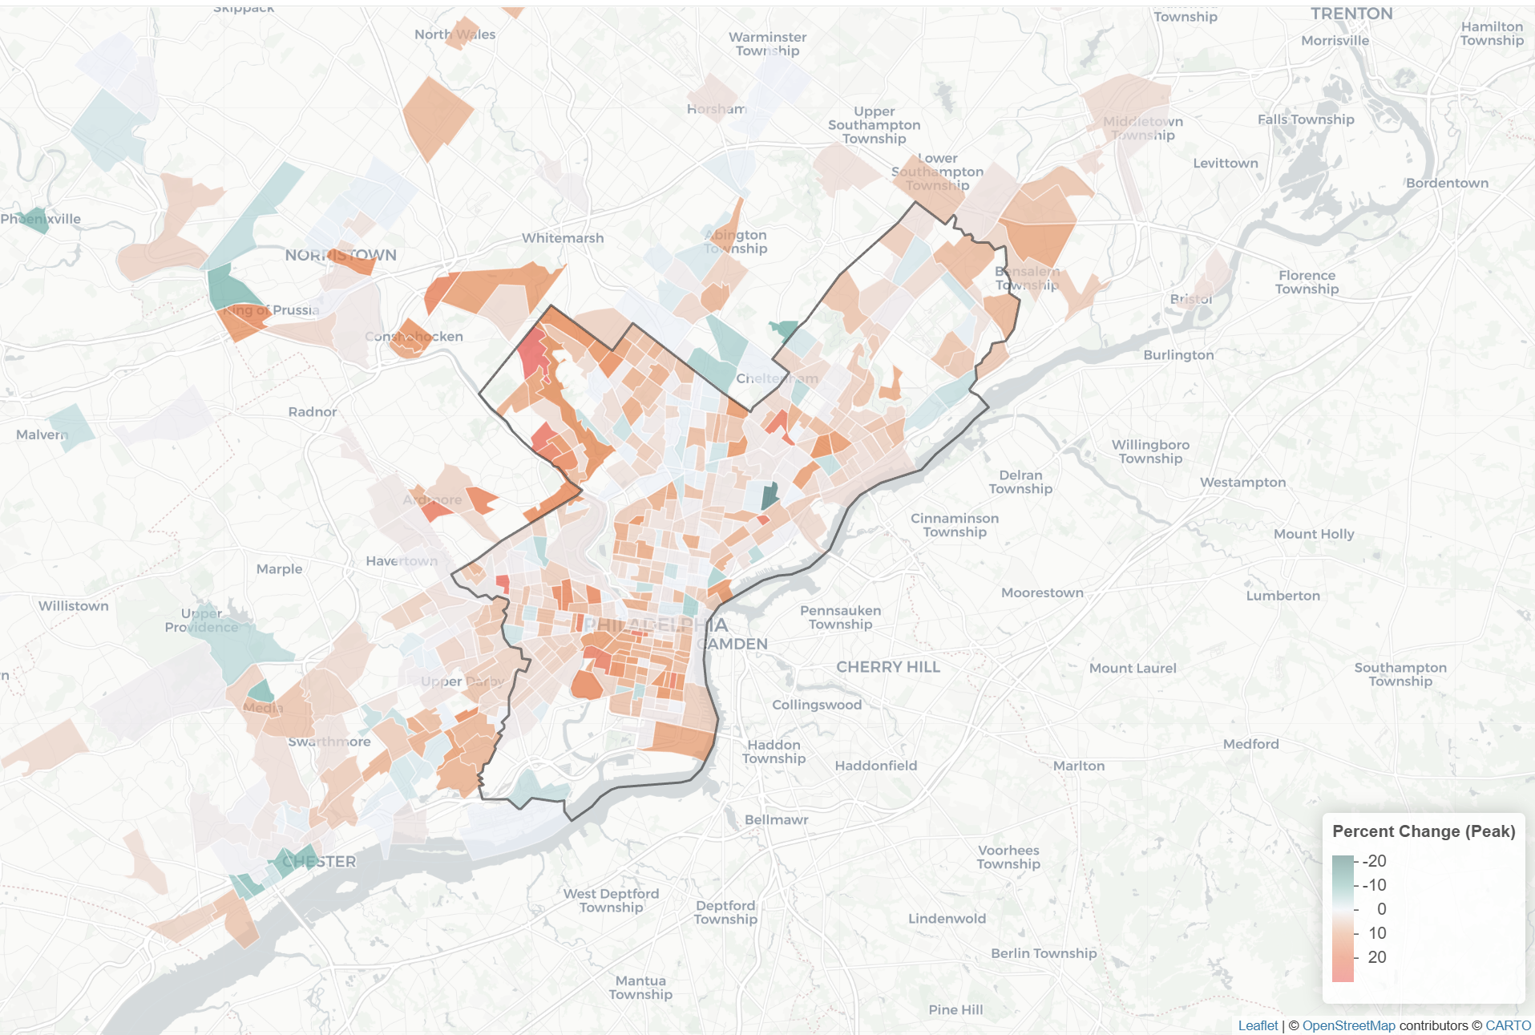
Peak Travel Time Percentage Change
Notes:
https://zyang91.github.io/septa-cut-analysis/percent-change-peak.html

Slide 19
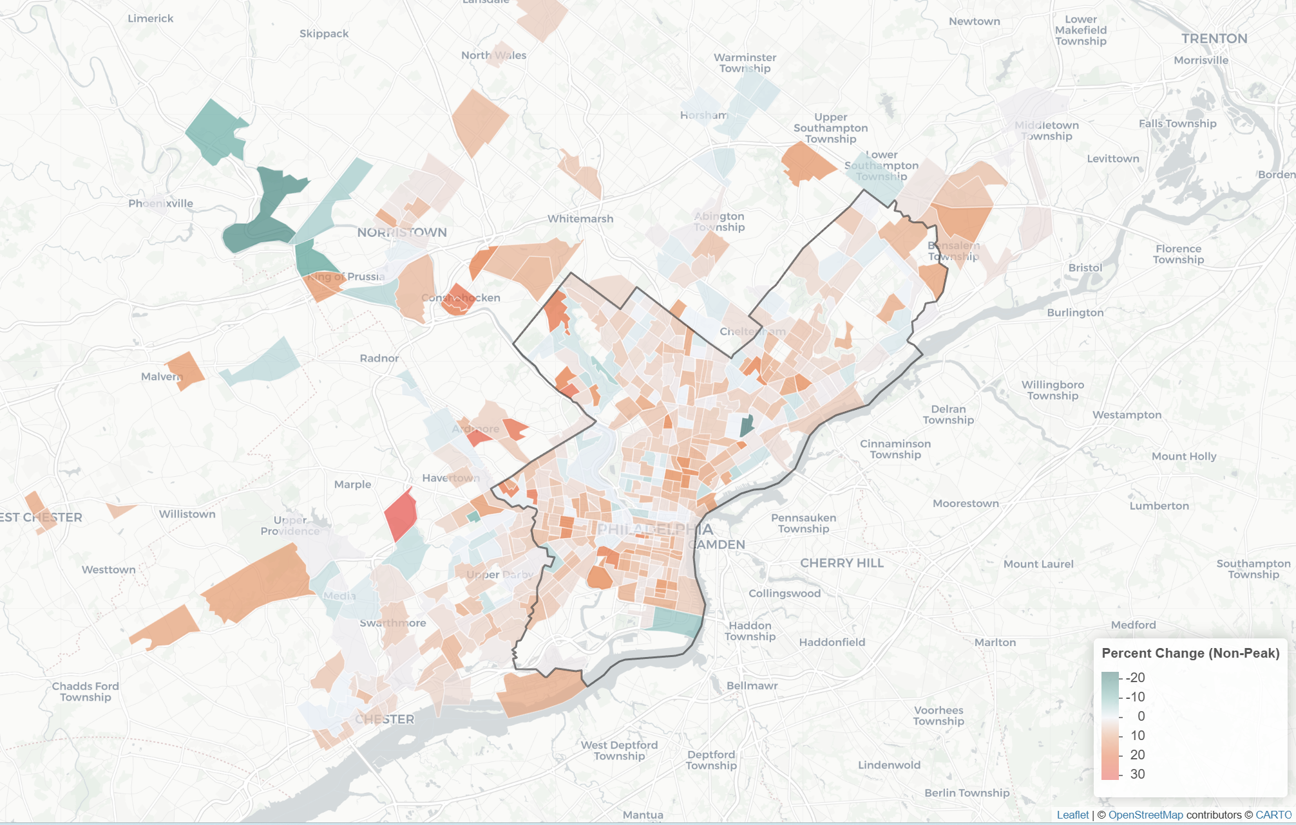
Non-peak Travel Time Percentage Change
Notes:
https://zyang91.github.io/septa-cut-analysis/percent-change-non-peak.html

Slide 20
04
Takeaway

Slide 21
Takeaway
Some neighborhoods face noticeably longer transit trips to City Hall after the proposed cuts.
The impacts are uneven across the city
Even “small” schedule changes can quietly reduce access to Center City jobs and services at the neighborhood scale.

Slide 22
Limitations
Assumes all trips go to City Hall
Based on scheduled times only (does not include real-world traffic, delays, or crowding.)
Uses simplified assumptions about walking and behavior (fixed walking speed, no changes in route, mode, or departure time).

Slide 23
Acknowledgement
This project is part of ongoing research on transit accessibility and service changes.
Special thanks to Dr. Elizabeth Delmelle, Dr. Xiaoxia (Summer) Dong, Dr. Erick Guerra for their generous guidance and support.

Slide 24
Reference
r5r – multimodal travel time analysis https://ipeagit.github.io/r5r/
tidytransit – GTFS data handling in R https://github.com/r-transit/tidytransit
SEPTA GTFS data https://github.com/septadev/GTFS
GitHub: https://github.com/zyang91/septa-cut-analysis/tree/main

